Slide 1

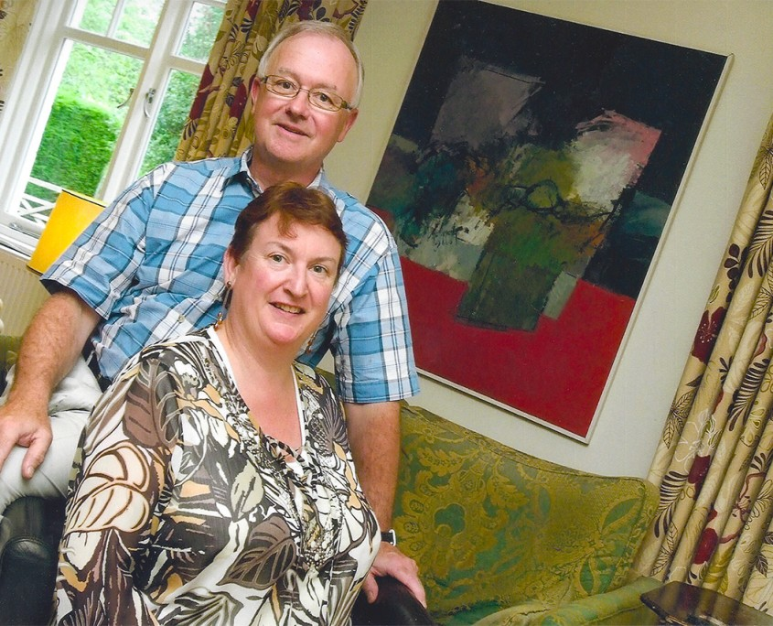
Host family presentation
Evelyn Philips: Head of hosting and school liaison
Eve leung: diRECTOR

Slide 2

Where do our host families come from?
From York to Truro in the South West
Bristol, Wells, Gloucester & Cheltenham
London, Surrey, Kent and Suffolk

Slide 3
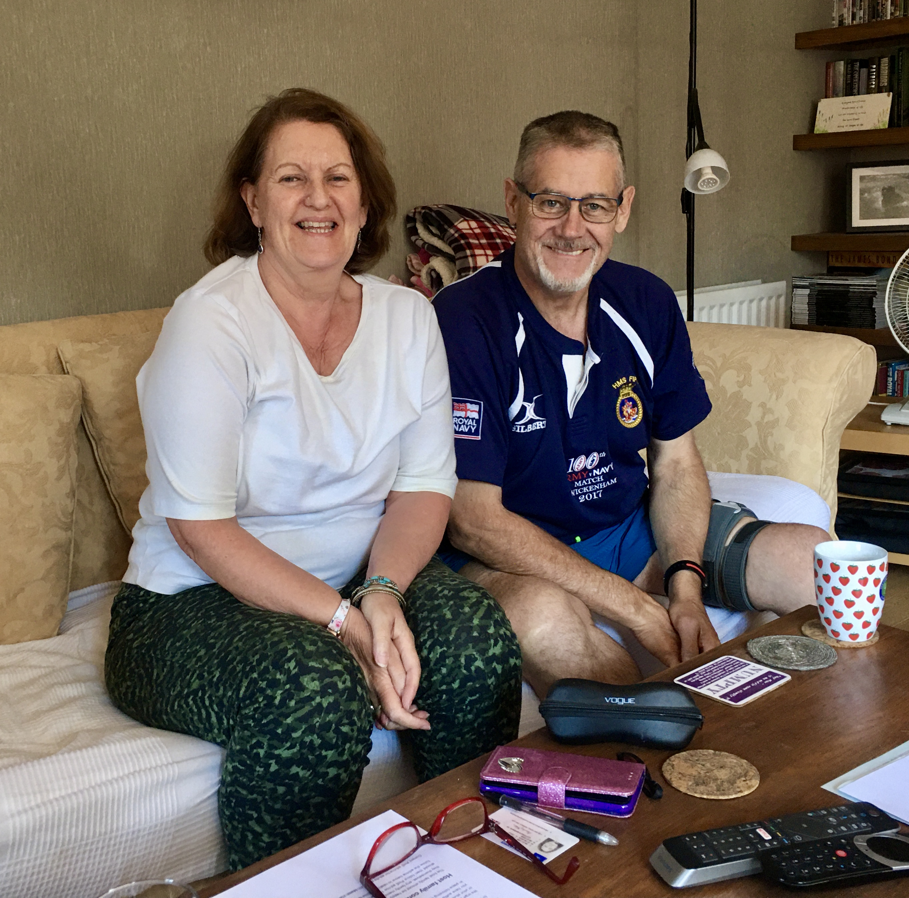
Who are our Host families
Married couples with children
Married couples whose children have left home say for University
Single parents
Broad ethnic backgrounds

Slide 4
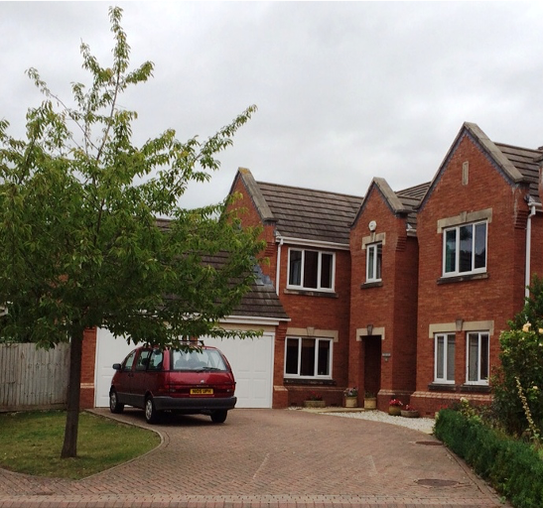
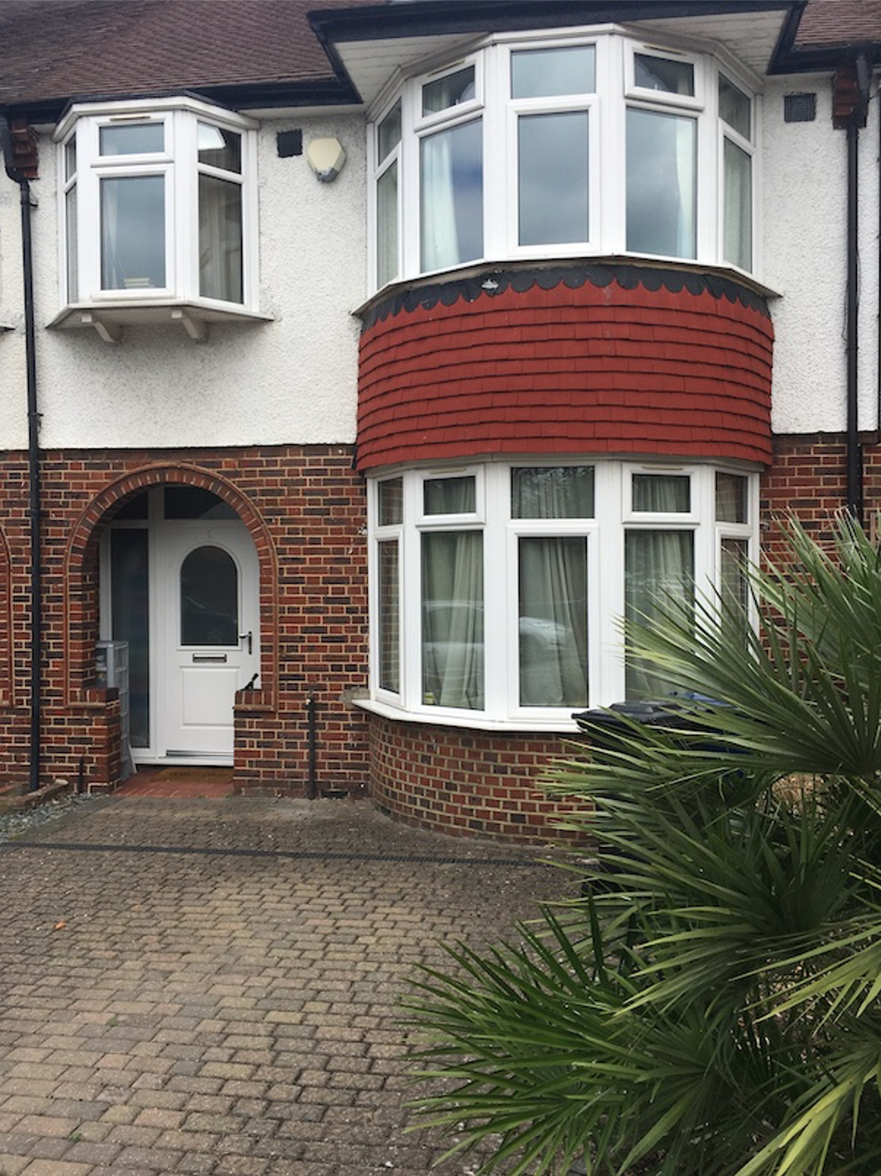

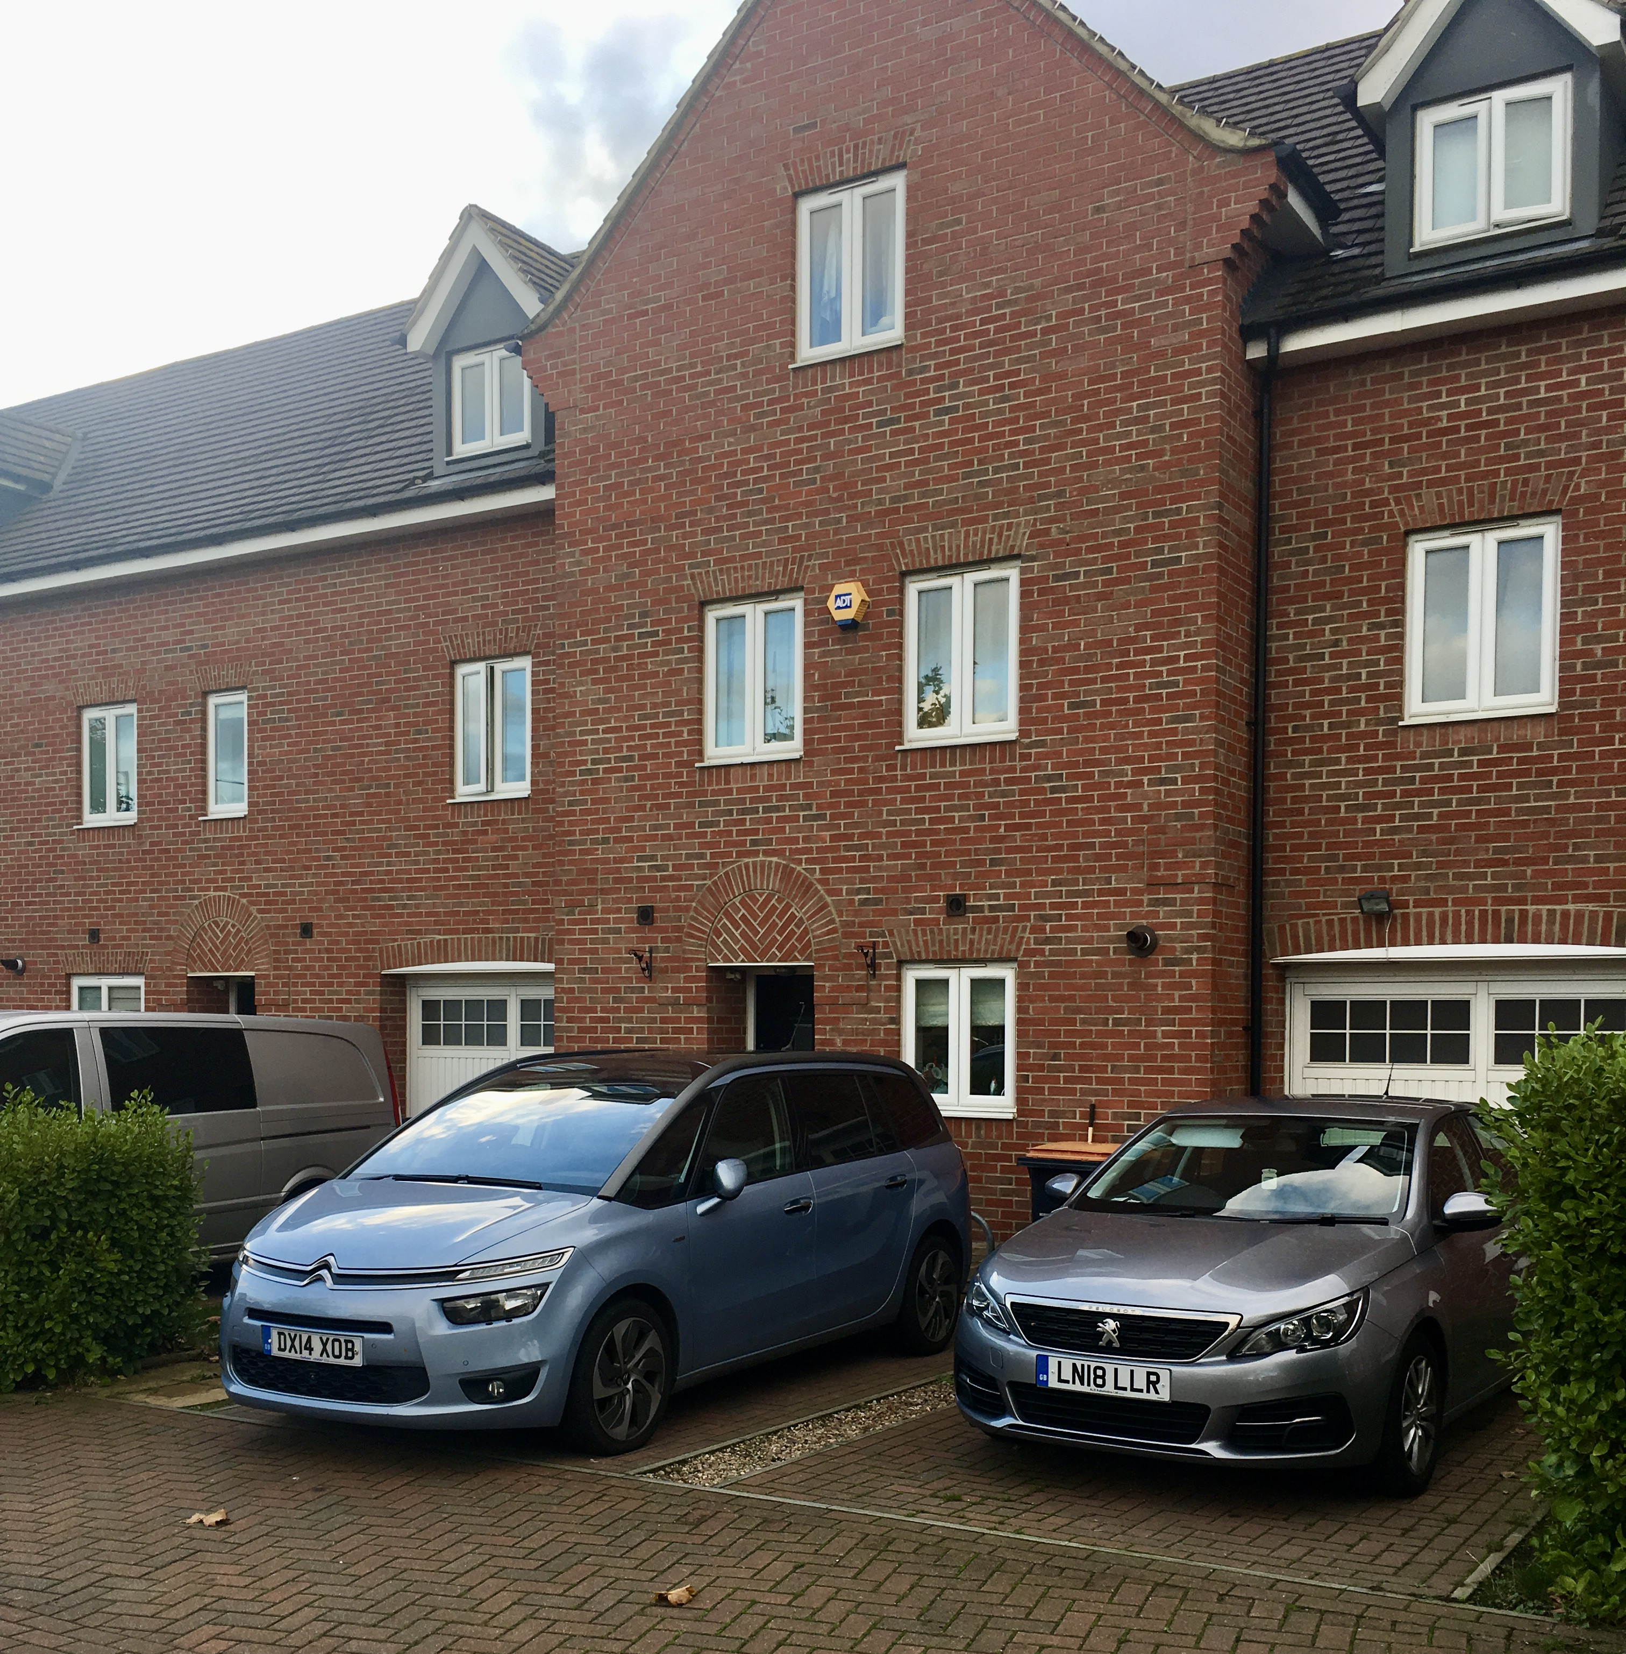
What sort of Houses do they live in?

Slide 5
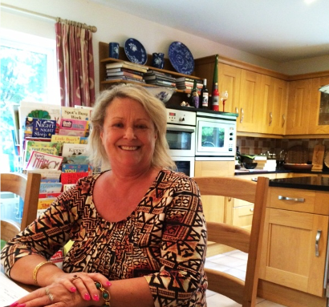
How do we select Host families?
They complete an Application Form
We take up 2 references
They have an initial visit that includes a full property inspection and risk assessment
Documents are checked and a DBS (Police check) is carried out on all residents over the age of 16
They are given a thorough briefing on Safeguarding, Health & Safety & all Elite’s key policies
We discuss students that we want them to host
They all will have online safeguarding training – Level 1.

Slide 6

When do students stay with Host families?
Exeat or Leave weekends – normally 2 to 3 nights (2 or 3 per term)
Half terms – can be from 10 to 17 nights
Long breaks from School e.g. Easter holidays for students in their final year of GCSE or A Levels
Other times – after the end or beginning of School terms because of flight arrangements
Emergencies - if they are ill at School, disciplinary situations, quarantine for Covid

Slide 7
What planning do parents need to do for hosting?
Check the School’s dates for exeats, half terms
Complete an Accommodation Request Form for Elite
Give an indication of the type of Host you would prefer but be prepared to be flexible about this
It is important to include any medical conditions and dietary requirements on the form so hosts can be advised.
Once completed then you are contractually committed for the first term (Autumn)
Changes can be made for subsequent terms if 5 weeks notice of changes are given.

Slide 8
What will Elite do after receiving your Accommodation Form?
Check our list of available Host Family, normally within 1 hour journey of the School
Send the Host Family a Booking Form giving details of the Student, School & Family Contact details and dates required for hosting.
Once agreed by Hosts send the Parents a Host family Information Form
Parents agree to Host Family or ask for an alternative
Elite Informs the School about the Host Family and dates when the student will be staying with them.
Elite sends out travel details before each stay with the Host Family to Parents, Student, School & Host Family.
Elite sets up a WhatsApp group for each student to monitor their journey to and from the Host Family

Slide 9
Why stay with a Host family?
It is a chance to be part of a British family and experience home life away from school
It is an opportunity for a different cultural experience – in terms of food and lifestyle
It is a chance to improve your English Language skills
Host families can provide support and help with educational and personal matters (for example attend Parent’s meetings)

Slide 10
What will a Host family provide for a student?
A warm friendly welcome
A clean and comfortable Room
Good heating, lighting and access to to the internet
Laundry especially for longer stays such as half terms
Food – 3 meals a day; breakfast, lunch & dinner (not all meals will be hot often lunch is not)
Snacks & drinks during the day – fruit, biscuits, milk tea etc.

Slide 11
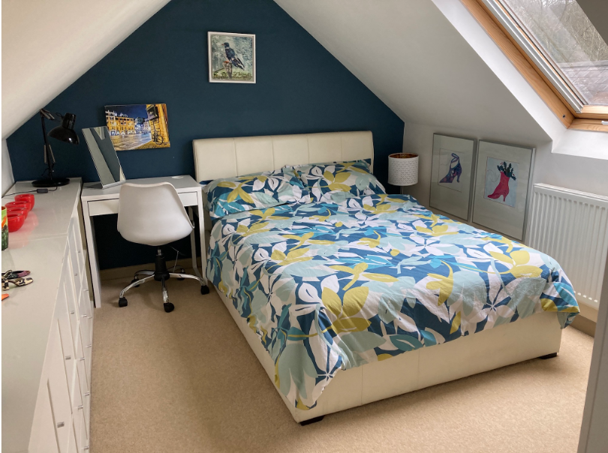
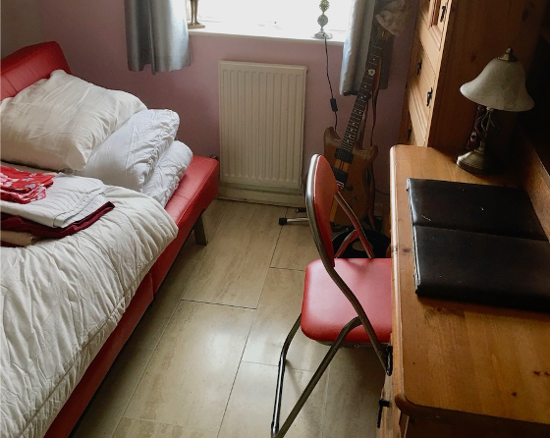
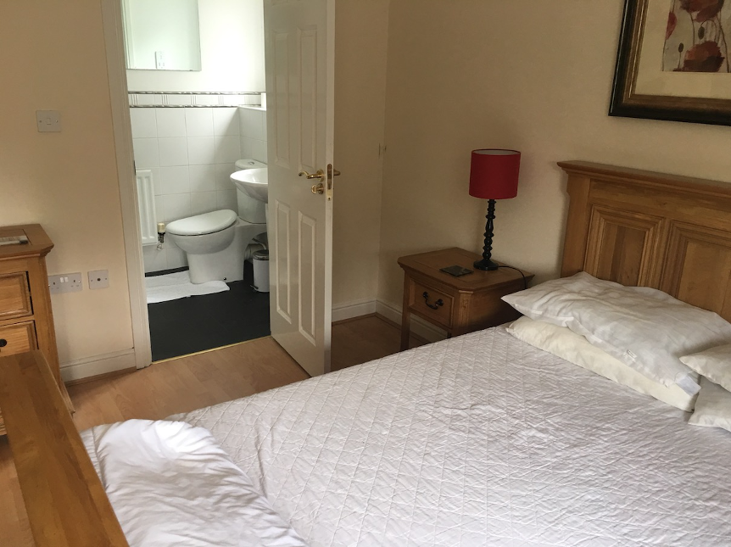
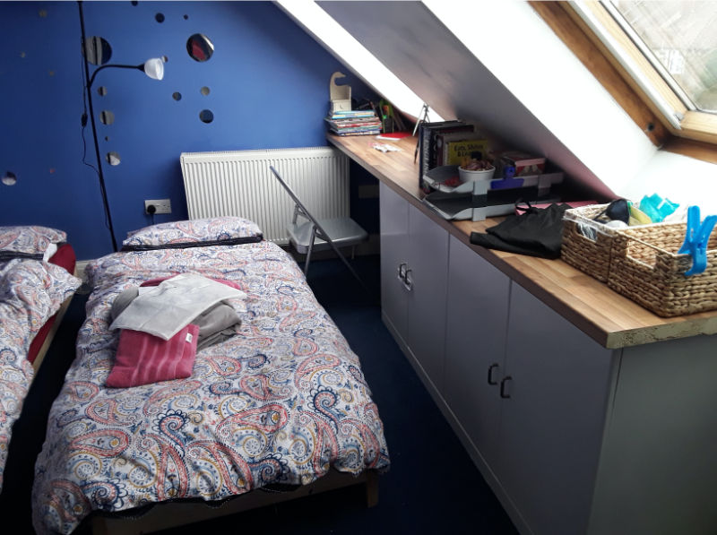
Examples of Students Rooms
It may be a single or double room
It may be shared
It may have an Ensuite bathroom/toilet

Slide 12
Do’s and Don’ts
Do’s
Do be polite & friendly – saying please and thank you are important when you family provides something for you.
Do take your meals with the host family
Do get involved with family activities
Do offer to help for example clear the table after mealtimes
Do keep your room and bathroom clean and tidy
Do keep to your Host Family Rules – these will be explained on arrival
Do keep in touch with your family before, during & after your stay

Slide 13





Do’s and Don’ts
DoN’Ts
Don’t stay in your room all the time
Don’t be noisy late at night
Don’t take a bath or shower for too long or at unreasonable hours
Don’t watch inappropriate material from the internet
Don’t be late getting up or late for meals
Don’t regard your host like a Hotel

Slide 14
A typical Day with a Host family
Breakfast – timings of this will vary from 8 am to 10am For Students aged 13 or under your host will get you up for breakfast.
Older students may wish to get up later, particularly on exeats, so they need to discuss timings that are acceptable for breakfast
Lunch – normally around midday and it may be sandwich, fruit or a hot meal like pizza
Dinner – this is normally a set time like 7 pm and this is the one meal students will be expected to sit down with the family.
Going out – Aged13 and under are not allowed out locally without the host
Aged 14 -15 can go out locally unsupervised but must have a mobile phone and stay in in contact with the host family and be back by 1800
Aged 16 and over can go out locally but must be back by 20.00
Visiting friends or going further afield can only happen if parents have given written permission (email)
Bedtimes (Guidelines) Aged 12 and under 21.30
Aged 13 and 14 22.00
Aged 15 22.30
Aged 16 and over 23.00

Slide 15
Check list of things to do before coming to the UK
Attend a parent's seminar or briefing
Read the Parents Handbook and sign the Contract
Read the Student’s Handbook and make sure your children do before they leave Hong Kong
Let us know the following as soon as possible:
Student’s contact details: mobile phone and email in the UK
Student’s boarding house details, house, house staff and their contact details
Any key medical information and medication you children are taking
Any allergies and special dietary requirements your children have
Make sure your children have our emergency contact details in their phones

Slide 16

Questions & Answers

