Slide 1



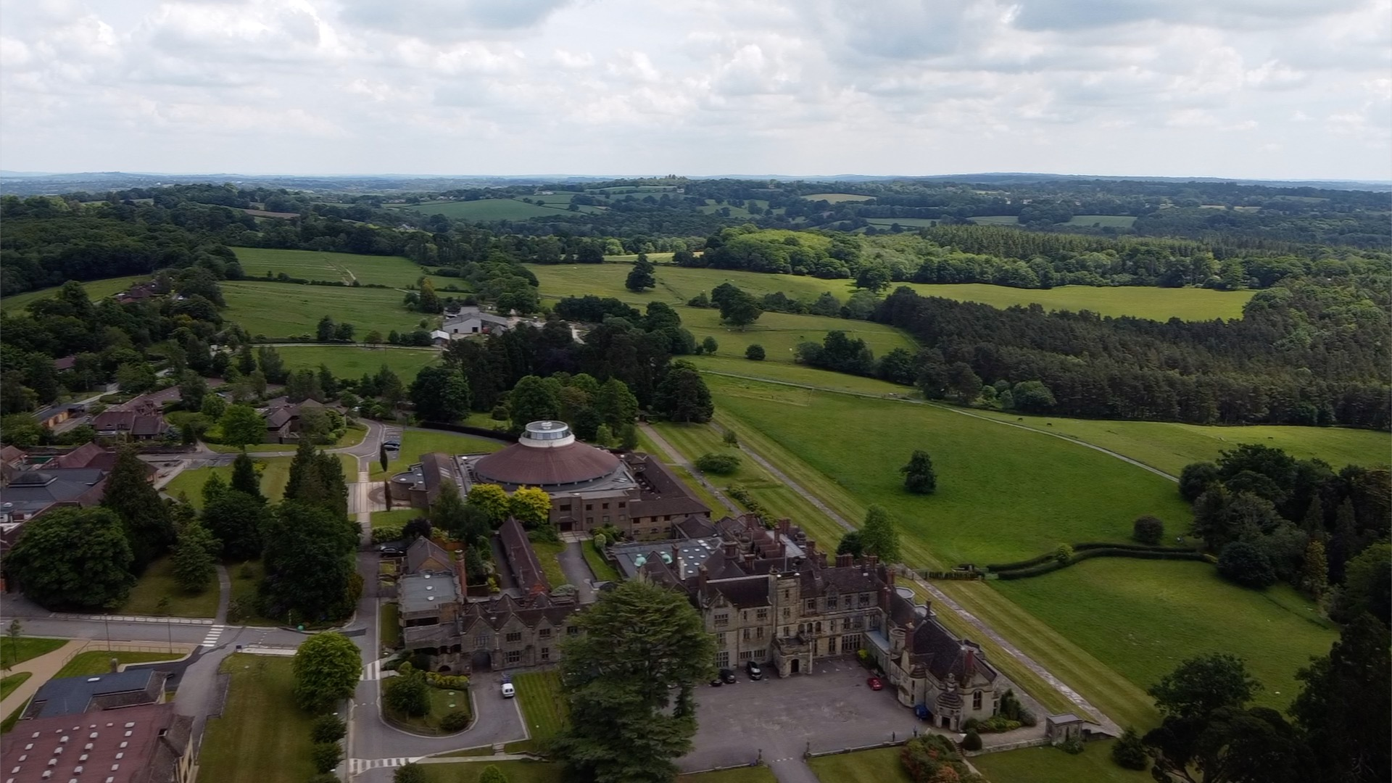
2022-23 Camp Rules
14th Oct to 30th November 2022
10th Feb to 19th February 2023
26th May to 4th June 2023

Slide 2
2022-23 Half Term Camp
Worth School
Address:
Worth School, Paddockhurst Road, Turners Hill, Crawley RH10 4SD
Boarding House: St Bede’s
Nearest train station: Three Bridges / Gatwick Airport Station
24/7 Emergency Contact:
Julian Godwin (Houseparent)
07541 417961
Sonia Fung (Deputy houseparent)
07517 753364
P2

Slide 3
Code of conduct
We want you to enjoy your holiday at our half term camp. You are away from school, but, for the safety, security and for the well being of all students and staff, it is important you follow some house rules.
Be aware that many of our students are studying. Therefore, you must be quiet in classrooms and near bed rooms used for study.
Please be on time for meal service, during which a register will be taken. Meals will not be available in the dining room outside service times.
A roll call will be taken every evening at 10.00 p.m., at which all students must be present. Following roll call, you should stay in your room, and you are not allowed to leave the boarding house, except if the fire alarm sounds, or in an emergency.
Students are encouraged to socialise in the downstairs common areas, or in the grounds. In the upstairs sleeping areas, boys are not allowed in the girls’ corridor, or in girls’ rooms, and girls are not allowed in the boys’ corridor or in boys’ rooms. You must not go into and the students’ bedroom, without that student being present.
Smoking, Vaping, the consumption of Alcohol and the Use of Illegal Drugs is not allowed at any time.
Look after your valuables. You keep all valuables at your own risk.
Always treat your fellow students and staff with respect. Saying ‘Please’ and ‘Thank you’ to staff, especially in the Dining Room, is very important. When you are in the presence of non-Chinese staff, whether from Elite or local staff, you must speak in English.
When outside the boarding house, show respect to people visiting the school grounds. If you wish to visit the lake during the day, you must inform a member of the Elite staff first. The lake is out of bounds at night.
Keep your rooms, kitchens and common rooms tidy. Offer to help, if you see someone else tidying up. If you cause any damage, immediately report it to a member of the Elite staff.
If you are concerned about anything to do with the running of the half-term camp, or if you are concerned about the behaviour of any student or staff member, please immediately contact a member of the Elite staff.
P2

Slide 4
Travel
If you would like us to fill in the Travel Form for you, please forward it to us by email (the school may not c.c. us on the Travel Form email)
If the Travel Form is on Parent Portal, we can’t fill in the form for you unless parents authorize school to open an account for us.
If school will arrange taxi booking. Student please pass on the address to your Housemaster or Housemistress directly.
If taxi is arranged by us, we will liaise with school on details.
Whether the taxi booking is arranged by us or the school, we will inform all parties, which include the housemaster, the student, and the parents about the taxi driver details, pick up time and location before departure (in some cases, we will not get the driver’s details as late as a day before, please be patient)
If you are going to Worth by train, the nearest station is Three Bridges. We will arrange transport to collect you from Three Bridges or Gatwick Express. Please inform Julian of the train routing you will take and what time you will arrive.
Three Bridges Railway Station
If you need our help in booking train tickets, advising your routing, or arranging particular pick up, please contact Julian.
What to do before holiday
We will create a WhatsApp Group for all students staying at half term camp. All details, such as arrival times, will be communicated among it. If parents have any questions, please contact us separately.
What to Prepare on The Day
Get yourself ready and pack your larger suitcases the evening before you travel. Pack necessary personal items in a small luggage right after class. You may also want to bring your computer and study items. Girls, please don’t overload your luggage especially for those need to travel by train.
Beddings are provided at the boarding house.Have your phone ready with batteries in any occasion.
Suggested items list: Shower gel, shampoo, towels, slippers, a pair of clean sports shoes, hair dryer if necessary
P2

Slide 5
Arrival at Worth School
Please drive to St Bede’s Boarding House. If you cannot find your way, please call us and we will meet you at the main reception.
Daily Routine
Breakfast: Service from 0830 to 0900. Please don’t sleep in very late in the morning, or even in the afternoon. Note that there is no breakfast service after 0900.
Students may do their study in their rooms or in classrooms.
Lunch: Service from 1230 to 1330
Afternoon: Students may continue to study in their rooms, or in classrooms. The Sports’ Hall will be available, supervised by a member of staff.
Dinner: Service from 1800 – 1900
Night Time: Group activities are very common. After dinner is a good time to talk and watch TV together.
A register will be taken at each meal service.
Night time roll call is at 2200 (10 p.m) – all students must be present for this roll call. This is also an opportunity for the group to meet, and to discuss anything to do with the running of the camp.
All rooms and corridors should be quiet from 2300 (11 p.m.) until 0800 (8 a.m.)
The boarding house has small kitchens, for cooking snacks, e.g. noodles. and live-in staff to take care of students. (No cooking after 10pm, except boiling water, absolutely no cooking after 11pm)
The boarding house has various recreation facilities such as pool table and football-game table
During the day, you are welcome to walk around the grounds. Day to day information will be posted in the WA group or on the white board on the ground floor of the boarding house. Make sure you regularly check this information.
Please don’t stay up very late at night or playing computer game in your room late at night.
P2

Slide 6
Bed Changing and Laundry
Laundry: provided on Thurs, and return on Friday
Please remember to label all laundry with your name, and bring laundry bag with your name attached to it.
Beddings: Cleaning beddings will be provided on Friday, and collected on Monday Morning.
If You Want to Go Out
Unless we have written notice by parent(s) to inform us not to allow their son/ daughter to go out, otherwise, students can go out on their own.
To go out, to either Crawley or Croydon or other destination such as Three Bridges, you must inform Julian 24 hours before, i.e. after lunch the day before. Julian will book a transfer for you. Students should be back before supper at 6.10pm (1810)
You bear your own risk when going out. If you go out without notifying us, we will treat it as a missing child . We will inform parents immediately and report to police if no contact has been made for 2 hours or more. (You are risking your record with student visa if you are reported as missing)
What to Do When There Is Concern
If there is any concern about food, daily arrangements, or for any other reason, please communicate with us immediately and directly. Complaining to your parents would not help the situation effectively. The beauty of coming to half term camp to stay with us is that you will develop a closer relationship with your guardian and Elite staff and, hopefully, we can guide you other than academically throughout your study years in UK.

Slide 7

How to Apply:
Complete application form:
https://www.eliteacs.com/holiday2223/
Enquiries:
info@eliteacs.com
Tel: 020 8144 2145

