Slide 1
The meeting will start at 11am
Please come back later

Slide 2
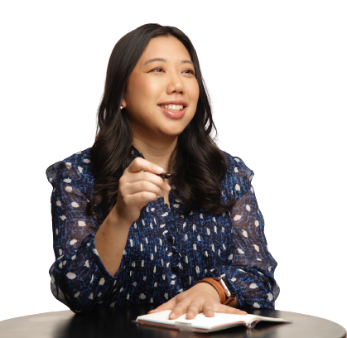
Hong Kong Entry requirements
Eve Leung
Director
Elite Anglo Chinese Services

Slide 3
✅Documents for entry to HKG
⭕PCR test 48 hours before flight
⭕Passport
⭕Hong Kong ID CARD
⭕Hotel reservation Letter
⭕HKG health declaration
⭕COVID Pass

Slide 4
Passport
(Parents)
6 months validity
Without 6 months validity, please only choose direct flight for returning home

Slide 5
ID Card
(Parents)
If student has turned 18 without applying for the adult version of the ID Card, they can board the flight.

Slide 6
Hotel Reservation
(Parents)
To show full name of the passenger on the reservation form
Re-confirm if parents need to accompany student (under 18) for the during of the quarantine
7 nights hotel. Even the passenger arrive late (i.e. 23:00) at the airport,you still need to have a reservation that covers the day of arrival

Slide 7
PCR test for Hong kong (Guardian/School)
Test to be conducted 48 hours before the direct flight into HKG
ISO 15189 or UKAS certified Lab
Cathay Pacific has recommended partners. There are also individual companies that offer testing with boarding schools
Certificate must show sample taken time, and the UKAS certificate
Indirect flight might have stricter requirement that the lab must be ISO 15189 certified
Flights flying on Mon, Tues and majority of the flights needs same day courier from school to make sure the lab can run the test in time for the student to board
Schools can assist with medical centre or boarding house to conduct the test, we appreciate if the school can help to post by priority post or have a destinated staff to assist testing

Slide 8
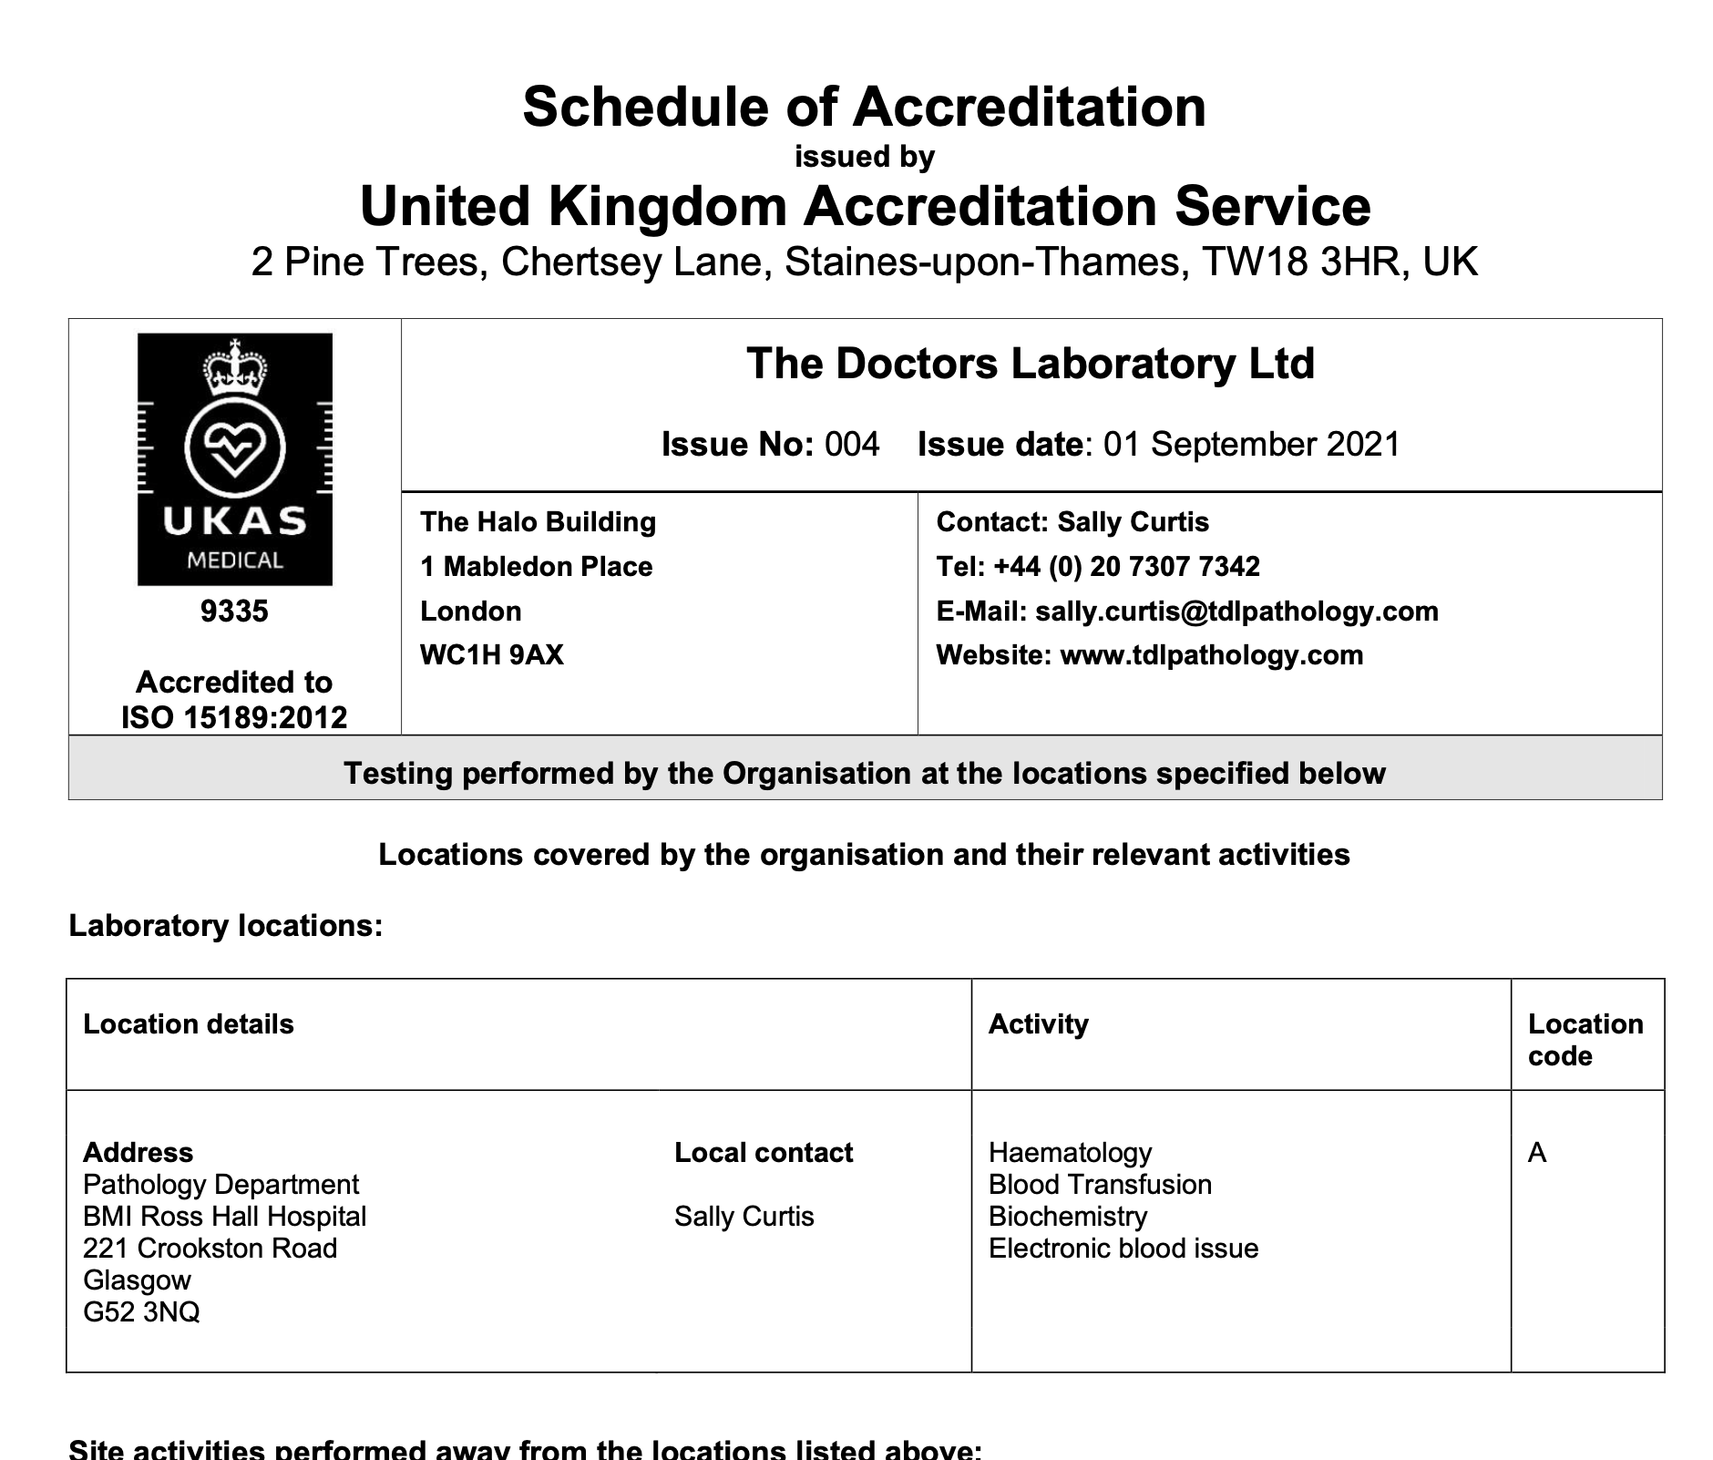

Slide 9
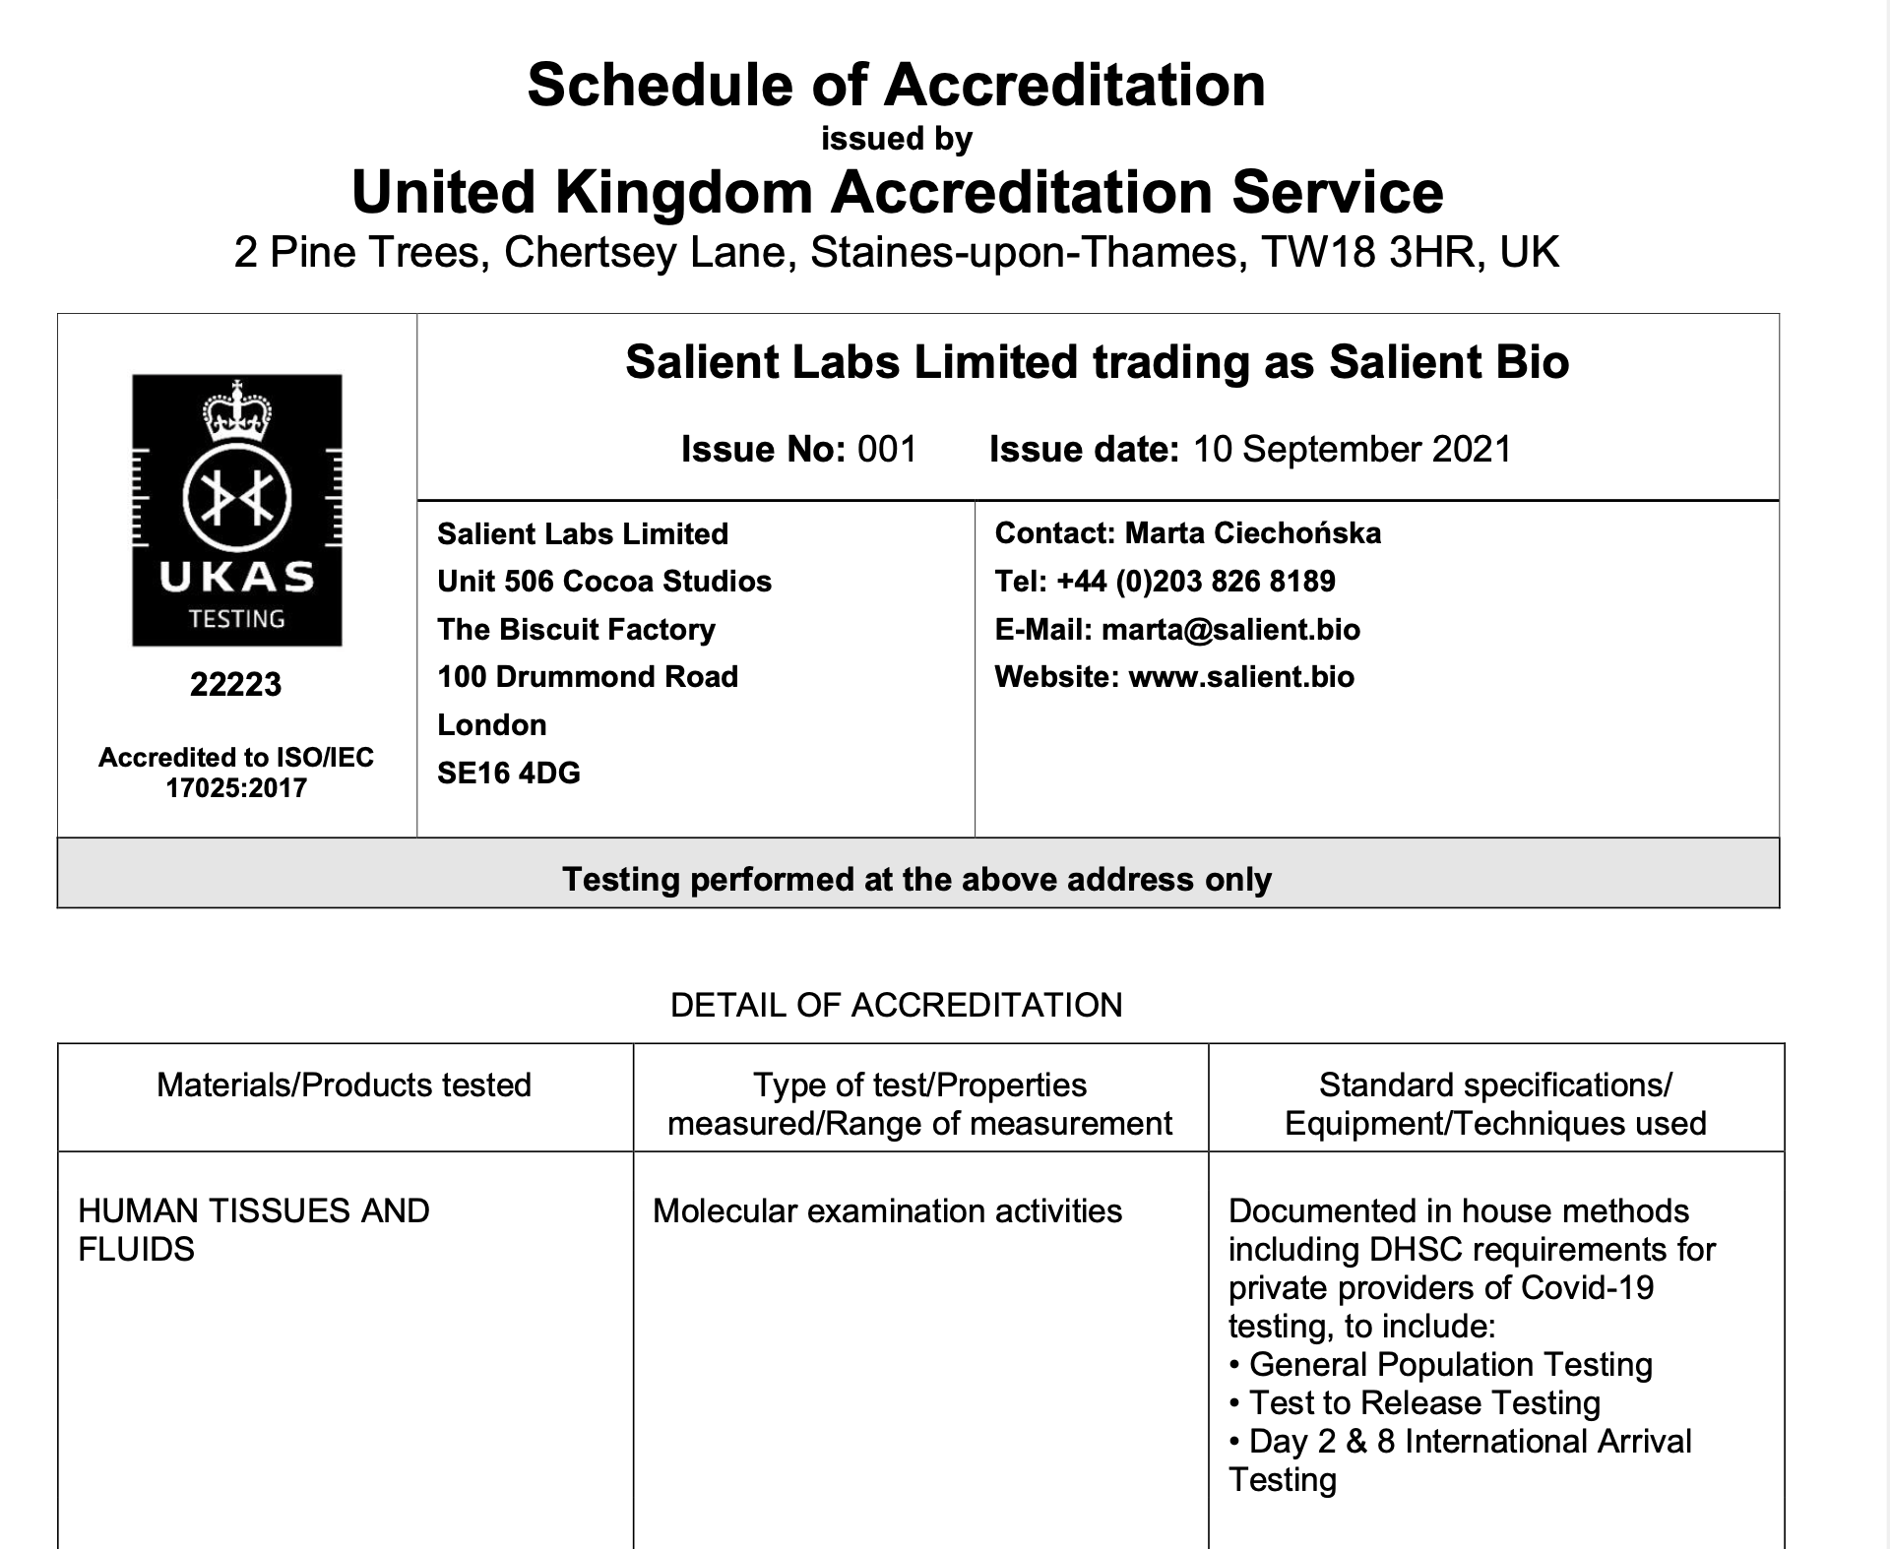

Slide 10
Vaccination Proof (Guardian/School)
HKG vaccination record
Print ok
UK Vaccination record
NHS covid pass (to print）,can apply even as 5 years and above
https://covid-status.service.nhsx.nhs.uk/ - online service (with app ver)
https://covid-status-letter.service.nhsx.nhs.uk/are-you-eligible - COVID Letter (5-11 can apply with 1 dose, but above 12 needs 2 dose to apply)
Need to verify with passport copy and selfie
Name: 例如 hiu fu leung, first name: hiu last name: leung
Address: school boarding address
NHS Pass: needs NHS number (to receive from GP practice)

Slide 12
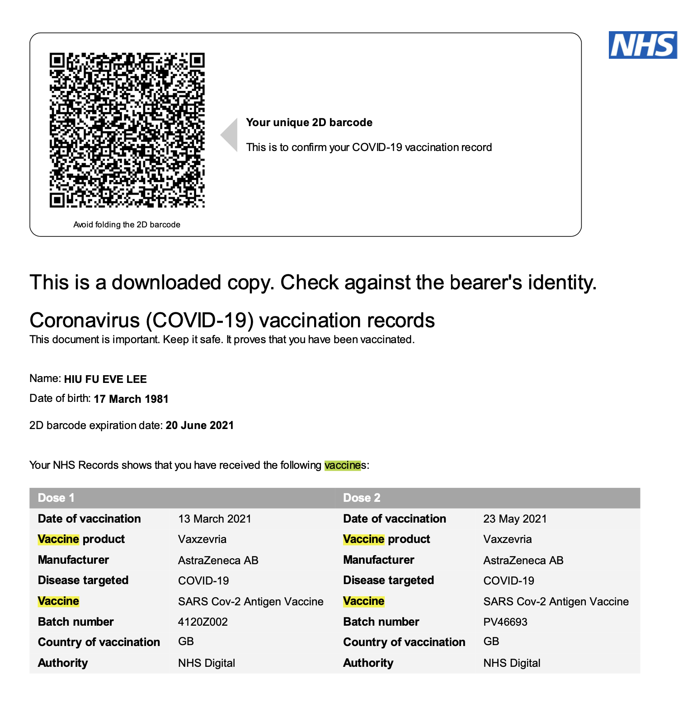

Slide 13
What if you do not have COVID Pass
Cathay pacific
Insist must be NHS PASS
Parents/School should call Cathay pacific for exemption
Hong Kong government
Can accept any evidence, i.e. GP letter even handwritten card record
Must show:
Passenger name
Dose (1? 2) and the manufacturer name (Pfizzer/Moderna)
Name of the vaccine must match HK government COVID vaccine list
https://www.coronavirus.gov.hk/eng/inbound-travel-faq.html?fbclid=IwAR1ts3ayg_catP3DJtsgsdOnnTT6iWsYf64lIhyImeXhFYN-a0ym1msrDCc#FAQB16

Slide 14
Question on COVID pass
If my name is Hiu Fu Leung (First name: Hiu Fu, Last name: Leung), can I board with just “Hiu Leung”?
Yes, the B14 Question on the FAQ answered，B14條款可以 https://www.coronavirus.gov.hk/eng/inbound-travel-faq.html?fbclid=IwAR3nsrDCAnBme_zwjwDOGtNNB5pzU9uf65Xstbmgz0_fLbxHjK752f9ls20#FAQB1
Cathay Pacific used to approve GP signed vaccine letter, do they accept that now?
They have since changed the policy and only accept NHS Covid pass
What if the student is age 11 and under?
They do not need to be vaccinated if accompanied by an adult that is fully vaccinated

Slide 15
Recovery certificate (Guardian/School)
Purpose
  There is a 3 dose requirements to enter public places to (2 dose for entry to HK, but 3 dose for entering public places if you are 12 years and older)
According to the Govt guidelines, you can be exempted the booster dose if you had covid after being fully vaccination
The recovery certificate can be converted at port of entry and used for entering public spaces
https://www.info.gov.hk/gia/general/202205/04/P2022050400716.htm

Slide 16
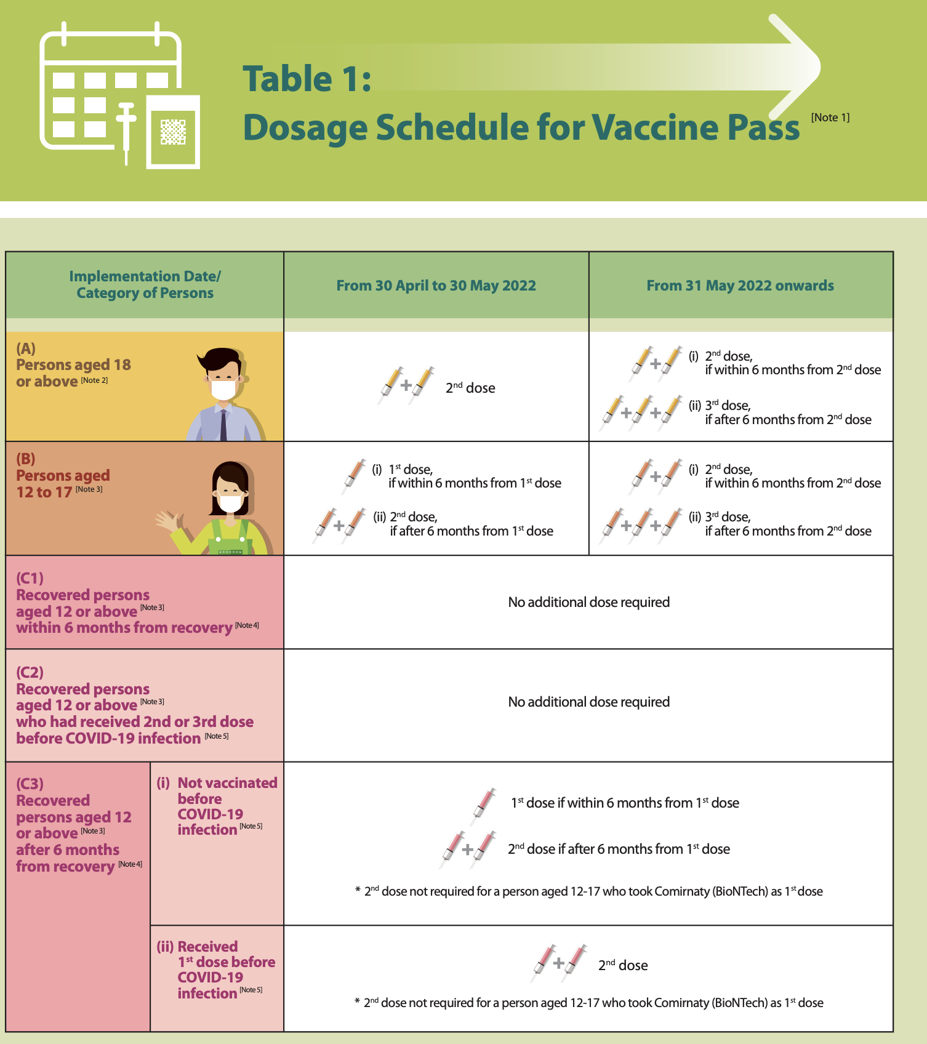

Slide 17
Going to airport
Luggage allowance (many counters only accept card payment for overweight luggages)
Check in 3 hours ahead (unless it’s a flight to Europe destination)
Remind students about security measure (no liquid /100ml only etc)

Slide 18
HKG Health declaration
Only complete with seat number
Can be completed at Arrival in HK

Slide 19
Help from school
NHS Covid pass
Posting and administering of the test kit

Slide 20
Macau Requirement

Slide 21
Macau Entry requirements
Hotel reservation
Under 18 , complete consent for Minor inbound travellers to undergo medical observation https://www.evaair.com/images/zhtw/mfm-minor-health-form-en_tcm27-76675.pdf submit via airlines for approval
48 hours PCR testing (from the first flight, i.e. from London)
18 and above Fully vaccinated within the last 7 months. i.e if the 2nd dose is done 10 months ago, a booster dose is needed
12-17, must have fully vaccinated with 2 dose, even 7 months been passed since the last dose

Slide 22
Additional requirements
Cannot return to macau if under 12, must be accompanied by adult
If had covid 2 months before entry to Macau, must have 3 LFT test results with 24 hours apart (Day 17, day 16 day 15 before boarding), or negative PCR test 14 days before departure
Anyone departing from Macau must have a negative PCR test 7 days before their departure
https://www.evaair.com/zh-tw/customer-services/covid-19-information-center/travel-restrictions/?countryCode=MO

Slide 23
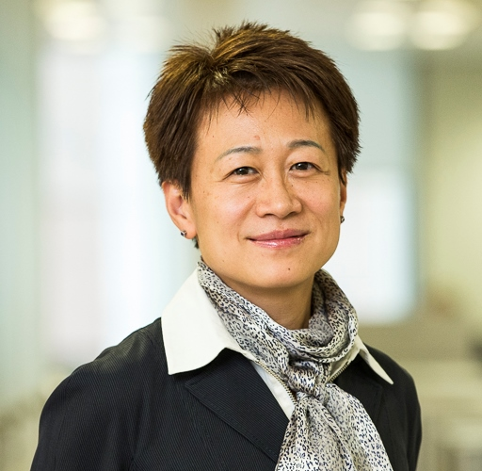
China Requirements
Lin Williams
CEO, Sirkka Networks
Chinese Embassy testing partner

Slide 24
China boarding requirements
Indirect flight via Europe
Testing before flight
Testing at transit (Dual PCR, must check individual country requirements whether antibody test is needed)
Health code approval by UK embassy and transit embassy (min 3 hours before first flight)
If had covid, needs to submit for pre-approval 6 weeks before flight

Slide 25
Stopover flights
Stopover flight to Singapore or Hong Kong (Follow Singapore/HK entry requirements)
Both required health code and dual PCR test from UK Chinese embassy before boarding
No health code required if stopover via HK for China, but required 7 days hotel quarantine

Slide 26
Questions
Eve Leung: eve@eliteasc.com
Sirkka Networks: corporate@sirkkaltd.com

