Slide 1


Preparation for returning to Hong Kong / China /Macau
Elite Anglo-Chinese Services
in partnership with Sirkka Networks

Slide 2
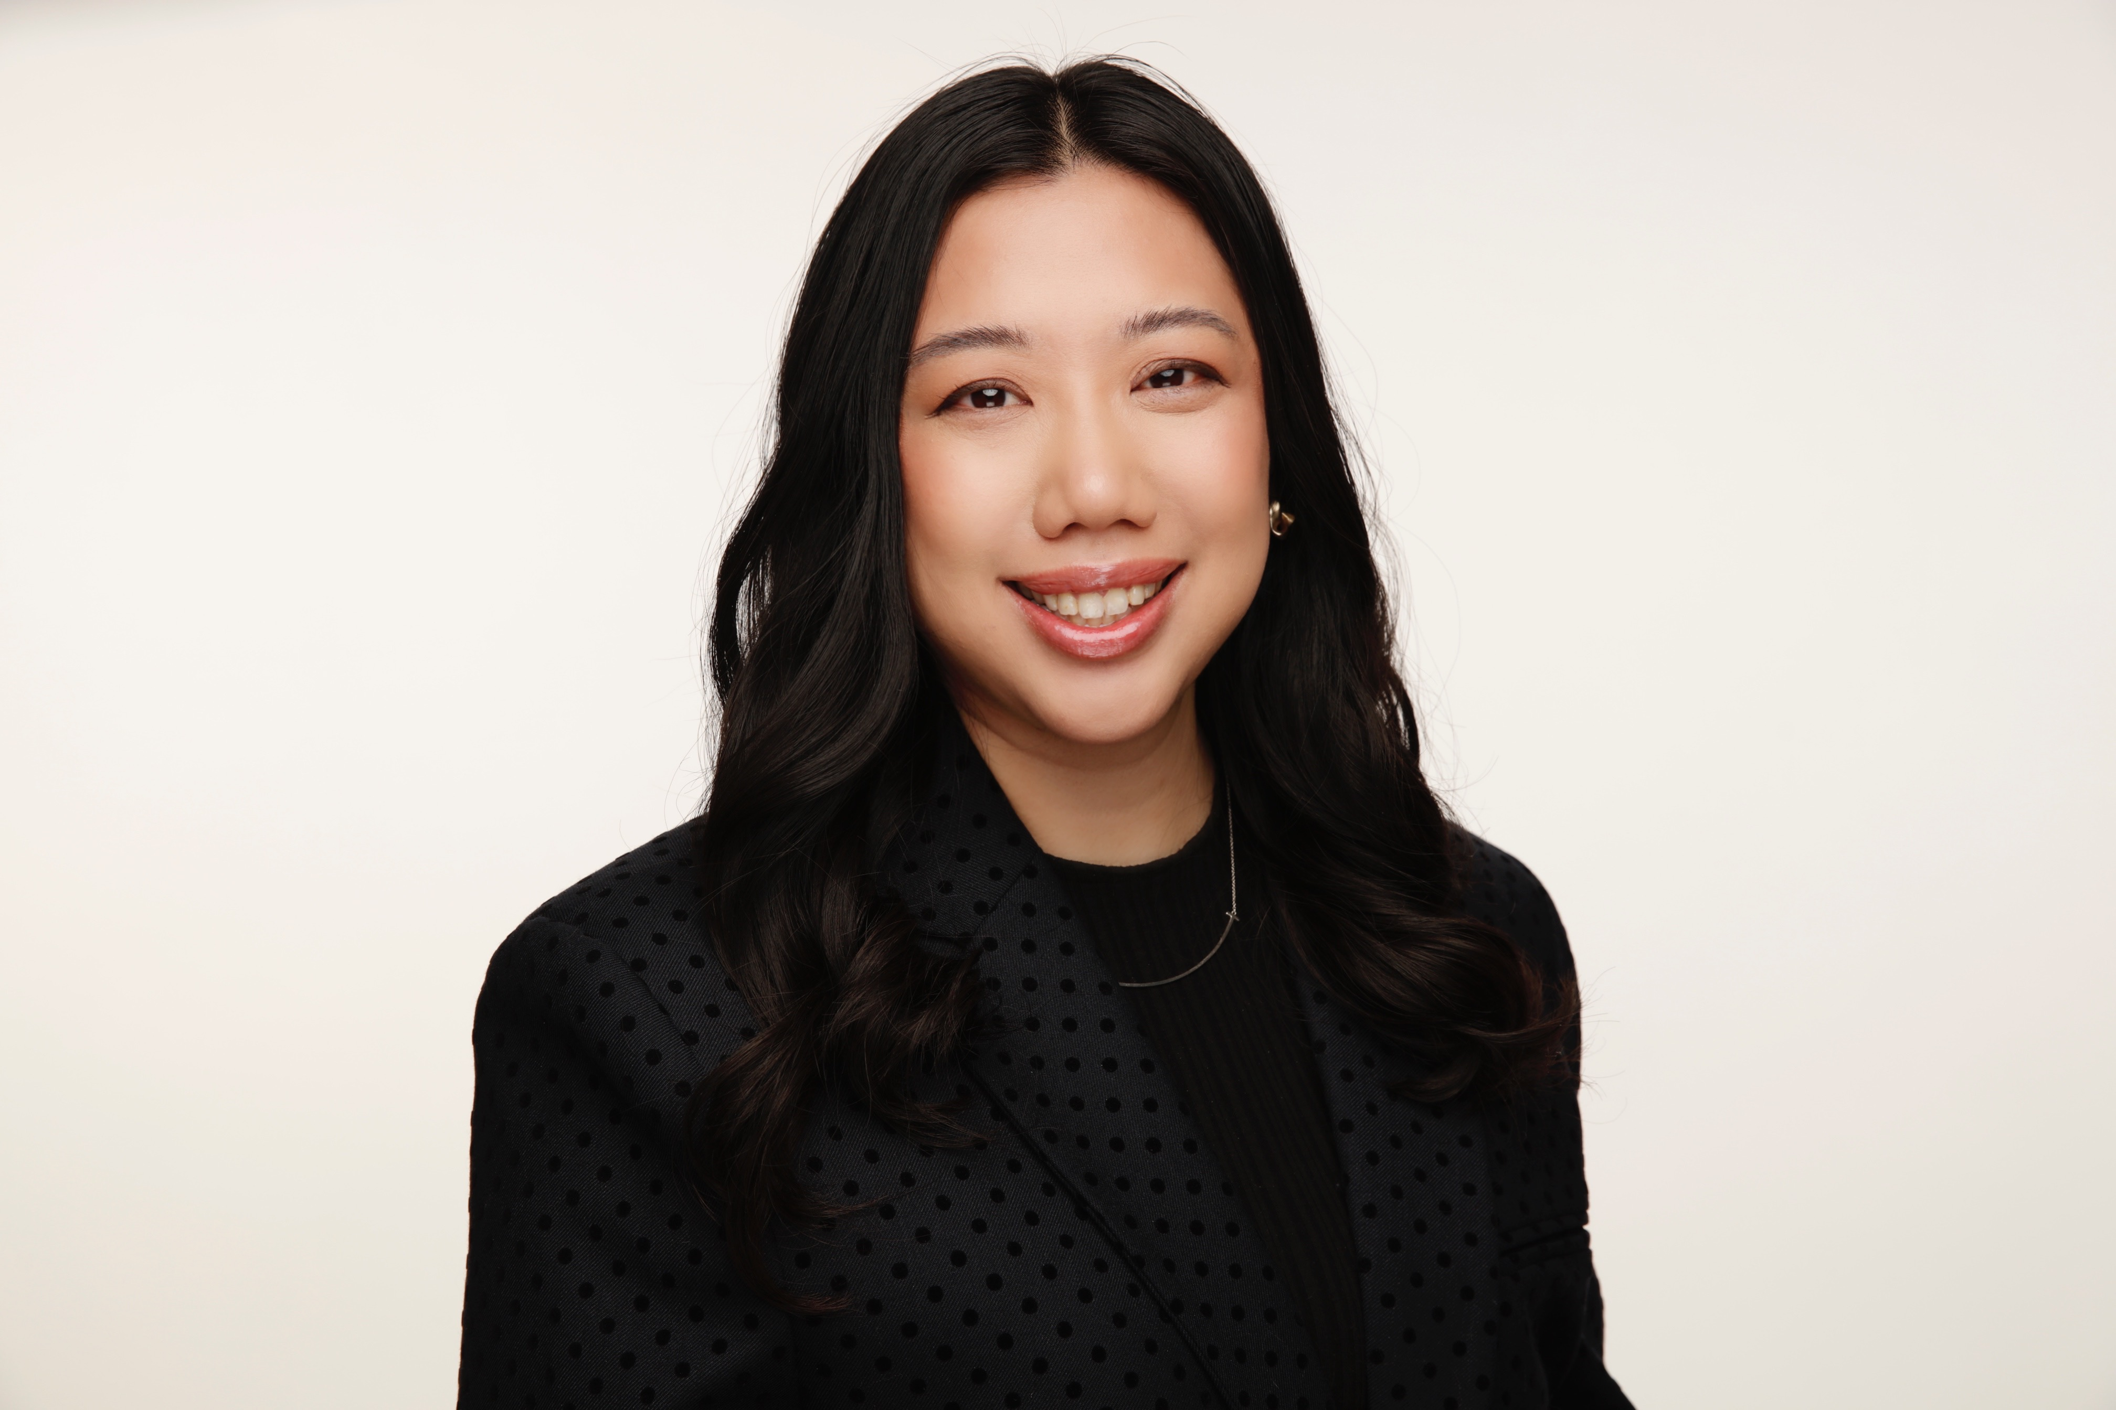
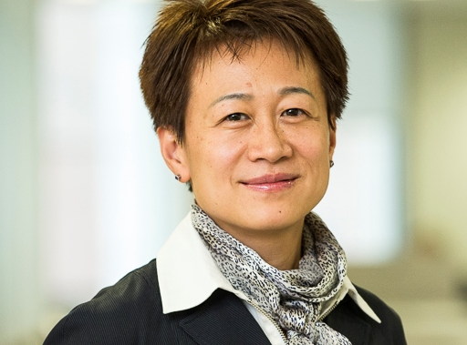
Who are we?
Eve Leung, Director of Elite Anglo-Chinese Services, working mainly with Hong Kong, Macau and Chinese students
Lin Williams, Founder and CEO
Sirkka Networks Limited
Lin has over 23 years of experience in the financial sector including insurance, banking, credit rating agency and investments. Lin has successfully established and grown new business platforms in Europe and China for publicly listed global companies. Lin spent over eight years at Arch group as MD at Arch Underwriters Europe and Arch Insurance Europe and CEO of Arch Risk Partners Ltd. Lin held a number of senior roles at financial institutions including Wachovia Securities, DrKW and Moody’s. Lin served as a member of the board of governors of CMSA-Europe (now CRE Finance Council) from 2005 to 2007. Lin holds an MSc degree from Massachusetts Institute of Technology, USA.

Slide 3
Hong Kong preparation
Pre-departure Testing
Documents requirement at check in
Hotel booking for quarantine
Government policy on flights

Slide 4
What do I need to enter Hong Kong
Pre-departure covid test results
Hotel reservation
Health declaration (with seating no. and QR code)
21 Days + 7 days self-monitoring
Flight booked
HK ID card

Slide 5
HK gov website flight + hotel list
https://www.coronavirus.gov.hk/
  Testing requirements (specific condition) (to be done in UK), now requies ISO 15189 on UKAS certificate, CQC certificate, UK government approved providers (??)
  Arrival procedures (for parents)
  Hotel quarantine list (can only stay at one of the government hotels) (parents)

Slide 6
CX website
RT-PCR Test (recommended)
72 hours before departure (sample taken time shown on certificate)
UKAS accredited (https://www.ukas.com/)
CQC accredited (https://www.cqc.org.uk/)
UK approved providers (https://www.gov.uk/government/publications/list-of-private-providers-of-coronavirus-testing/list-of-private-providers-of-coronavirus-testing)
https://www.cathaypacific.com/cx/en_GB/covid-19/hong-kong-travel-restrictions.html

Slide 7
Hotel quarantine
All travellers must quarantined in government destinated hotel for 21 days. Plus 7 days of self-monitoring (i.e. stay at home, do not go out unless necessary)
Hotels will impose restrictions for under 18 years old staying alone
Parents need to seek permission to stay with passenger if they are under 18 or under the hotel rules for 21 days
3-5 swap test to be done during quarantine and self-monitoring period

Slide 8
What do I need to do to go China
Pre-departure testing (PCR Test + Antibody test) within 48 hours of departure
Transit airport testing (PCR + Antibody test) at the transit airport
No direct flight at the moment
Quarantine for 14 days
Must have International Health code (Green) for boarding
  Slight different process to obtain the green code for Chinese passport holders vs. non-Chinese passport holders
  Submit results to Chinese Embassy in London, Manchester Consulate General or Edinburgh Consulate General

Slide 9
At the airport
Passenger must already shows a Green code at boarding (airline does not accept testing paper work)
Passenger should apply for International health code via wechat app
Arrive 4 hours before departure
Itinerary (including transit arrangements)
If any problem, ask a staff at the check in counter for assistance

Slide 10
China pre-departure testing
Should be taken at Embassy authorized provider only
  Different lists for the Embassy, Manchester Consulate and Edinburgh Consulate
http://www.chinese-embassy.org.uk/chn/lqfw/P020210406862722426585.pdf
Need to attend clinic or arrange a nurse for testing
Antibody test involves venous blood sample
Passenger can only apply for transit testing after they receive the international green health code

Slide 11
Macau
No direct flight (HK close for transit for Macau passengers)
Chartered flight on 17/June and early July
Covid test requirement: 72 hours before departure https://www.ssm.gov.mo/docs/18234/18234_8a91a819f8f544e58b26d6a8f1affee4_000.pdf
Signed parental agreement for isolated medical quarantine for under 18 passengers https://www.evaair.com/images/zhtw/mfm-minor-health-form-en_tcm27-76675.pdf
Under 11 cannot travel alone to macau
Ref: https://www.evaair.com/zh-tw/customer-services/covid-19-information-center/travel-restrictions/?countryCode=MO
21 days quarantine

Slide 12
Q&A
Contact us:
Eve Leung : eve@eliteacs.com
Lin Williams: care@sirkkaltd.com

